Slide 2
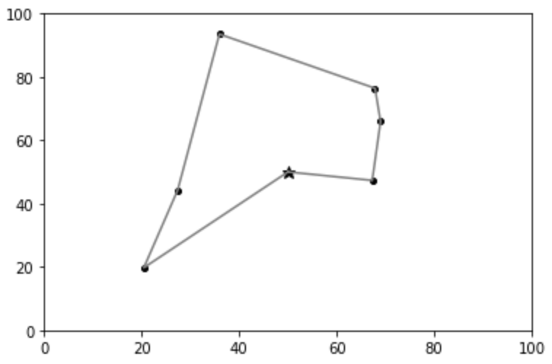

Slide 3
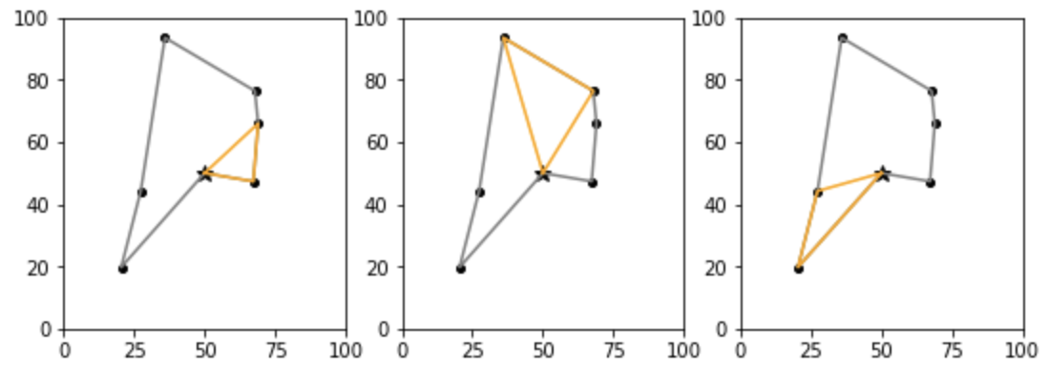
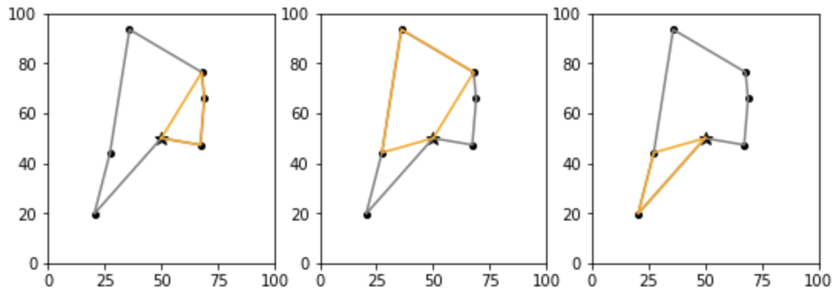
Giant tour:
4
3
2
5
1
6
Primary routes:
Extended routes:

Slide 4
Giant tour:
4
3
2
5
1
6
Primary routes:
A: {1,2}
B: {3,4}
C: {5,6}
Extended routes:
A: {1,2,3}
B: {3,4,5}
C: {5,6}

Slide 5
Primary routes:
Realized trips:
A: 11
8
3
B: 4
4
C: 9
8
1

Slide 6
Primary routes:
Realized trips:
1 (4)
3 (4)
7 (7)
A
3 (3)
1 (1)
B
7 (7)
C
1 (2)
1 (2)

Slide 7
Extended routes:
Realized trips:
1 (1)
1 (4)
3 (4)
7 (7)
A
3 (3)
5 (7)
B
2 (7)
C
2 (2)

Slide 8
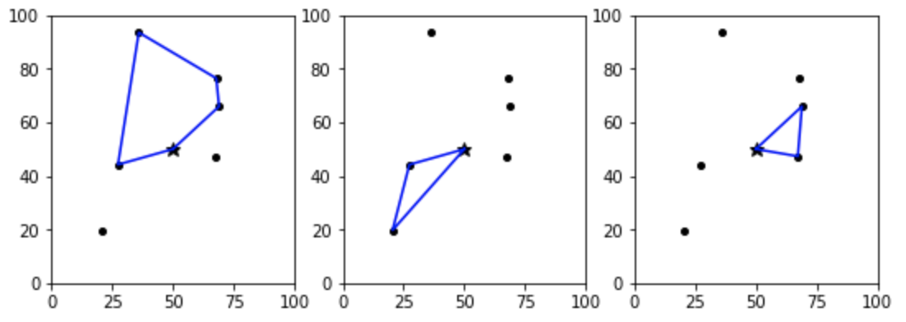
8
8
8

